Slide 1

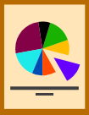
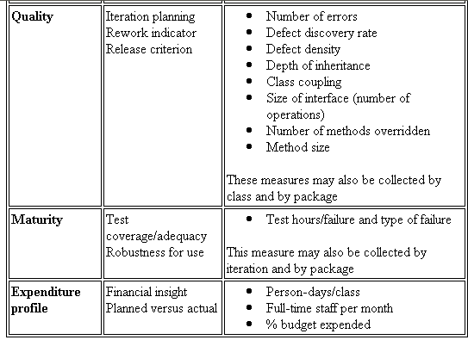


UML Diagram – What is UML?
The Unified Modeling Language (UML) is a standard language for
Specifying
Visualizing
Constructing
Documenting
Business Modeling
Communications

Slide 2
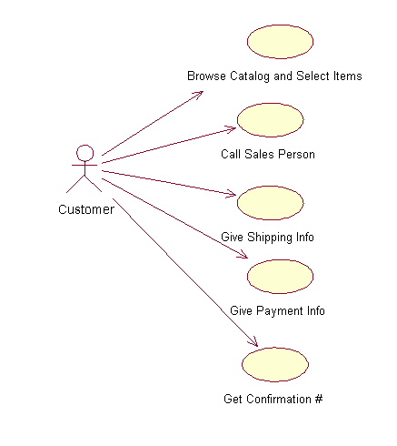
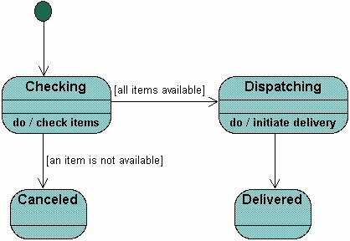
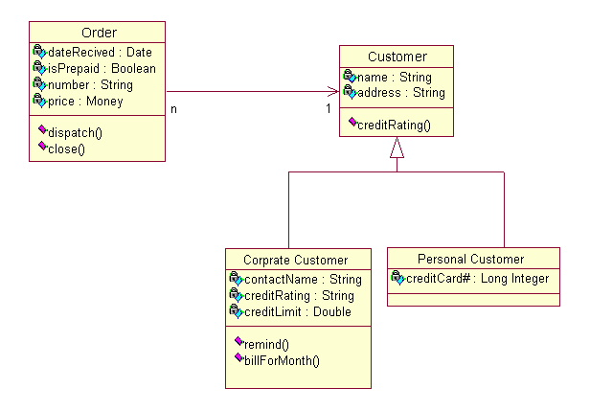
Different Views
Users
Designers
Analyzers

Slide 3
Use case diagram
System boundary
Actor
overview the usage requirements
presentations project stakeholders
"the meat" of the actual requirements
Actor:
An actor is a person, organization, or external system that plays a role in one or more interactions with your system
Use case
Online C2C shopping

Slide 4
System boundary:
indicates the scope of your system. Anything within the box represents functionality that is in scope and anything outside the box is not

Slide 5
Use case:
A use case describes a sequence of actions that provide something of measurable value to an actor and is drawn as a horizontal ellipse

Slide 6
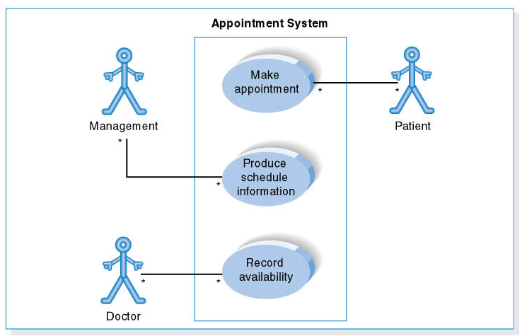
Use Case Diagram for Appointment System

Slide 7
Class Diagram
Name
Class diagrams show the classes of the system, their interrelationships (including inheritance, aggregation, and association), and the operations and attributes of the classes.
Associations
Aggregation
Generalization
Relations
Attributes
Operations

Slide 8
Relationships between Class Diagrams
Association -- a relationship between instances of the two classes. There is an association between two classes if an instance of one class must know about the other in order to perform its work. In a diagram, an association is a link connecting two classes.
Aggregation -- an association in which one class belongs to a collection. An aggregation has a diamond end pointing to the part containing the whole.
Generalization -- an inheritance link indicating one class is a superclass of the other. A generalization has a triangle pointing to the superclass.

Slide 9
Interaction Diagram
Describe how group of objects collaborate to get the job done.

Slide 10
Describe the behavior of the system by viewing interaction between the system and its environment.
Interaction arranged in a time sequence
2 dimension vertical and horizontal

Slide 11
Collaboration Diagram
Set of objects related in particular context and interaction
Sequence indicated by numbering

Slide 12
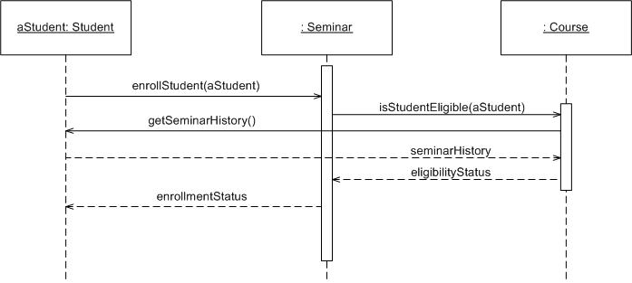
Sequence Diagram
Object: Class
A sequence diagram is
An interaction diagram that details how operations are carried out.
What messages are sent and when.
Sequence diagrams are organized according to time
Message
Operations
Lifeline

Slide 13
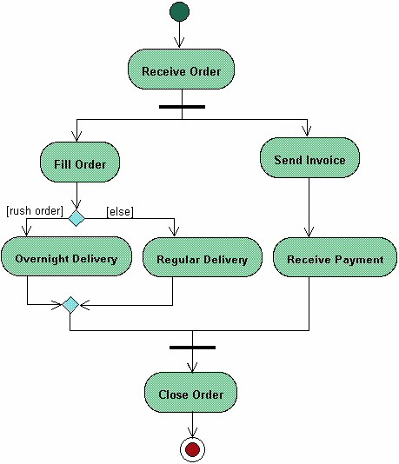
Activity Diagram
Start
Fork
Activity diagrams describe the workflow behaviour of a system
Branch
Merge
Join
End

Slide 14
State Machine Diagram
A State Machine diagram
shows the possible states of
the object and the transitions
that cause a change in state.
?
What is different between activities and Statemachine diagram

Slide 15
Implementation Diagram
Show implementation phase of the system development
  source code structure
  Run-time implementation structure

Slide 16
Component Diagram
Show the dependencies that the software has on the other software components
Structure of the code itself
  Source code
  Executable program
  UI

Slide 17
Dependency
Interface notation

Slide 18
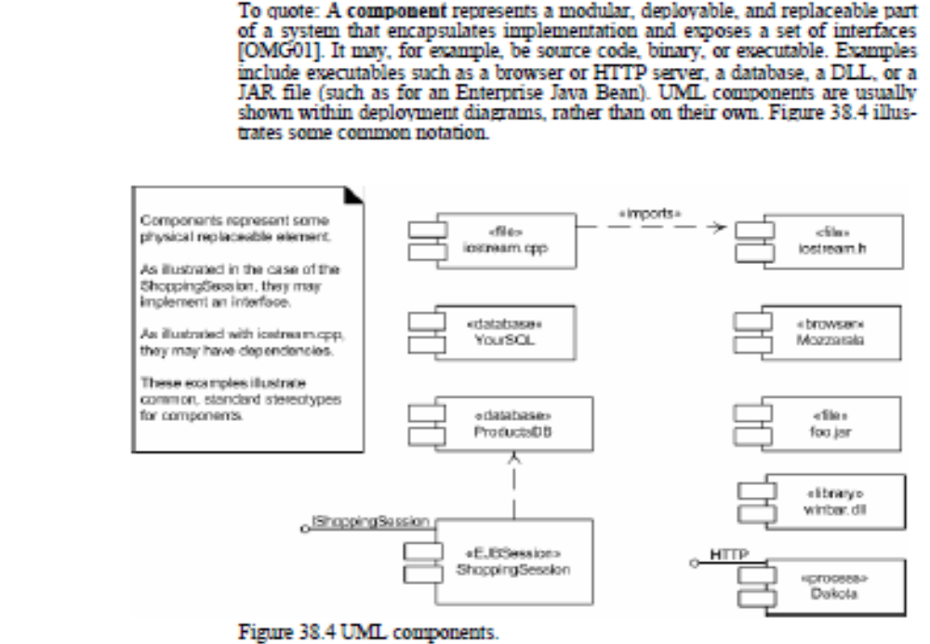

Slide 19
Deployment Diagram
How a system will be physically deployed in the hardware environment
Show structure of the runtime system.
Is a graph of nodes connected by communication association.
Nodes contain component instances, which means component lives or runs at that node.

Slide 20
Device node –computer,mobile phone
Execution node-web browser,VM,OS,EJB CONTAINER

Slide 21
